Slide 1






Xyz
Project : JOBLANCE
Team: Guide: UMA MAHESWARI
MUSKAN - muskann1309@gmail.com
SAHELI PATRA - patrasaheli499@gmail.com
AKANKSHA BISHT - akbisht9868@gmail.com
Disclaimer: The content is curated for educational purposes only.
Notes:
Slides: Prepare a short slide deck (10-12 slides) summarizing the project objectives, methodology, and key results.
1

Slide 2
Xyz
OUTLINE
Abstract of the Project
Problem Statement
Proposed Solution
System Architecture
Live Demo of the Project
Embedded Video of Project
Conclusion
Future Scope
Notes:
2

Slide 3
Xyz
Abstract
JobLance is a modern job portal designed to simplify job searching and recruitment. It provides an intuitive interface where users can search for jobs based on location and category. Key features include job listings with details like company name, location, and job type, along with an AI assistant for user queries.
The platform ensures a seamless experience with a responsive UI and easy application process. Developed using front-end technologies, JobLance focuses on UI/UX principles, making job hunting efficient and accessible for all users.

Slide 4
Xyz
Problem Statement
Location-based job discovery : Many individuals face difficulty finding job opportunities in their preferred states or locations, leading to missed career opportunities and untapped talent.
Limited awareness of corporate companies : Job seekers often struggle to discover and connect with small corporate companies in their desired location, resulting in overlooked job prospects.
Networking gaps for skilled professionals : Despite having impressive resumes, many individuals lack effective networking channels to connect with potential employers, hindering their job search efforts.
Restrictions and preferences in job search : Job seekers often have specific preferences (e.g., location, industry, company size) and restrictions (e.g., relocation limitations), making it challenging to find suitable job opeings.

Slide 5
Xyz
Proposed Solution
Allowing filter option to users to specify location preferences and restrictions.
Providing a verified list of small corporate companies in desired locations.
Facilitating networking opportunities between job seekers and potential employers
Offering personalized job matching based on user preferences and resume data

Slide 6
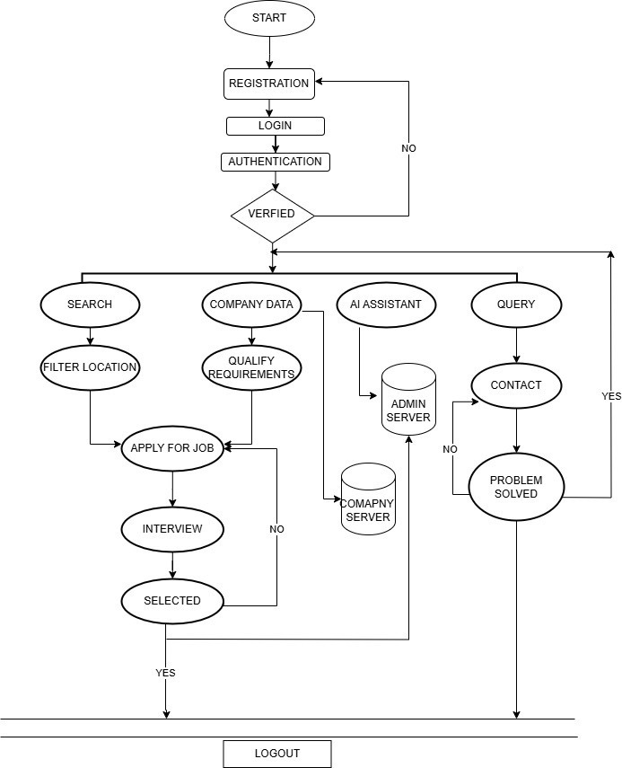
Xyz
System Architecture

Slide 7
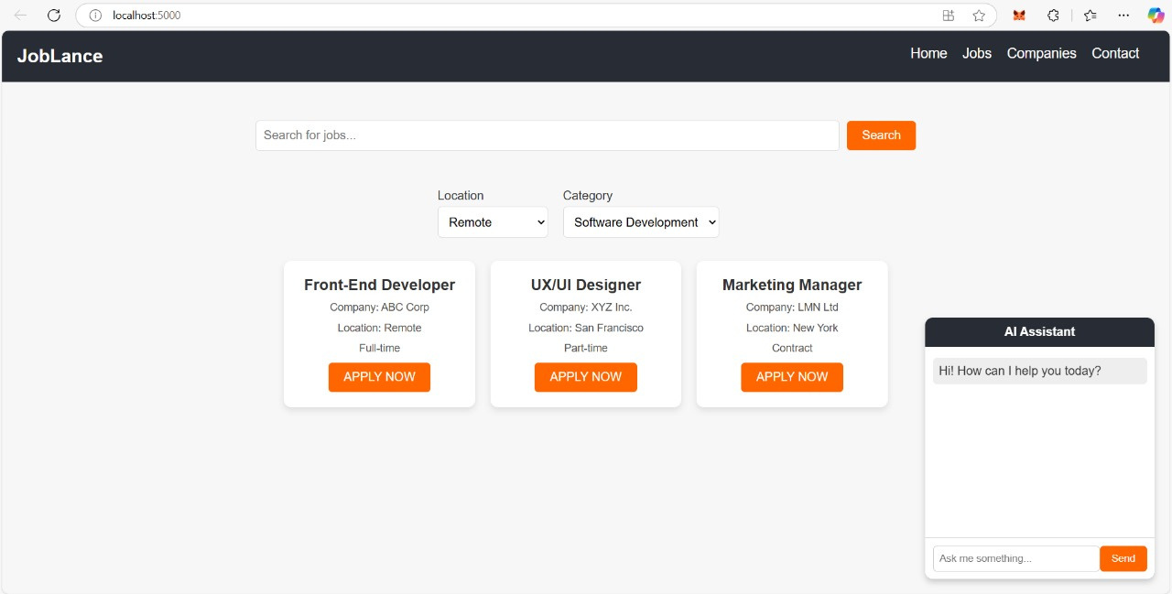
Xyz
Live Demo of Project

Slide 8
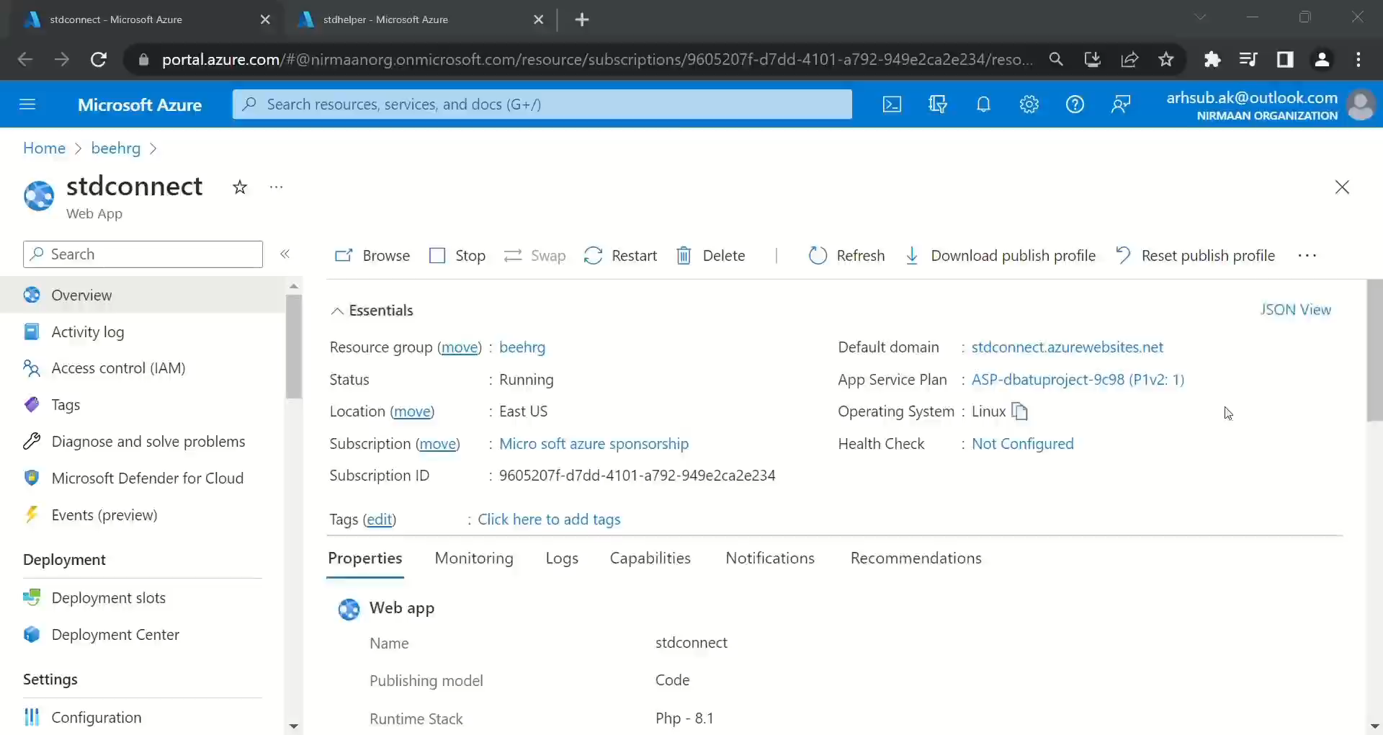
Xyz
Video of Project Demo

Slide 9
Xyz
Conclusion
In conclusion, our freelancing job portal project aims to bridge the gap between job seekers and employers across different regions and states. By providing a platform that connects professionals from diverse backgrounds and locations, we envision a future where talent knows no geographical boundaries. Our platform offers a unique opportunity for individuals and businesses to connect, collaborate, and thrive, providing unparalleled access to job opportunities, flexible work arrangements, and global connectivity."

Slide 10
Xyz
Future Scope
As our freelancing job portal grows, we will add new features. In the future, we plan to improve our services by using artificial intelligence to match jobs, creating personalized learning paths, and making it easier for people to work together. We'll also make sure our platform is safe, secure, and can handle more users.
We want to use new technologies like blockchain and virtual reality to change the way freelancers and employers work together. By listening to our users and keeping up with industry trends, we'll keep making our platform better and help freelancers and employers achieve their goals.

Slide 11
Xyz
Thank you!
Notes:
thank you very much for joining this PPT, keep learning.
11

